Slide 1
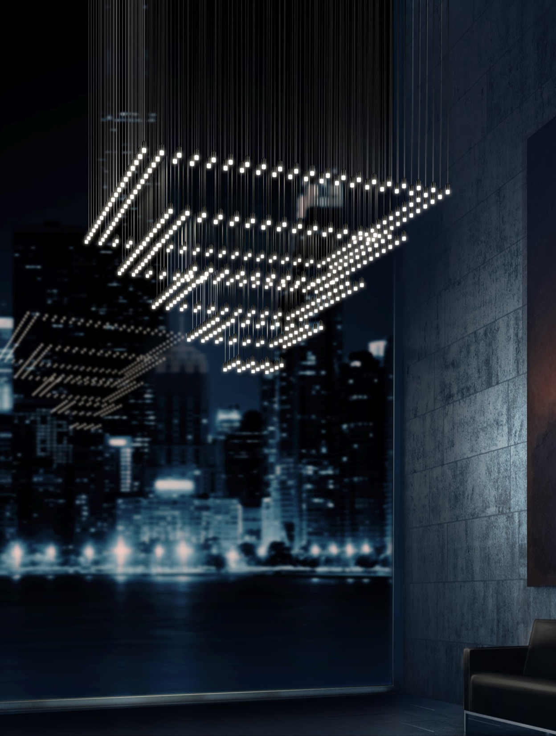
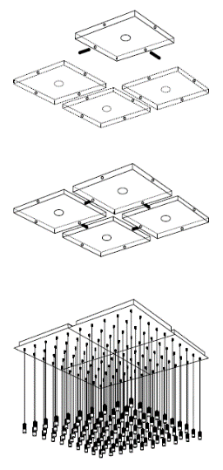
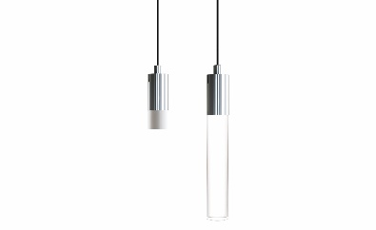

QUATRO
NEW
BUILD YOUR OWN:
Config and ports
Lighting & finish
Pattern
SINGLE PART NUMBER:
Consult new price sheet
SSC-096P-XX-27U-XXK
Notes:
$40k installation
100 per pendant
400 pendants

