Slide 1
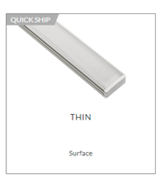
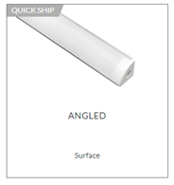
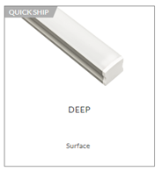
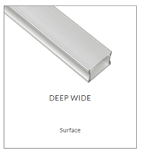

OUR “COOKIE CUTTER” PROGRAM
QTY > 30 OF SAME SECTION LENGTHS < 8FT
SHIPS FULLY ASSEMBLED W/ 4FT LEAD
~ 20% DISCOUNT OFF DN (REFLECTED AT UNIT PRICE)
GREAT FOR MULTI-FAM, HOSPITALITY, OFFICE, EDUCATION
Notes:
Take a foto of this slide

