Slide 1

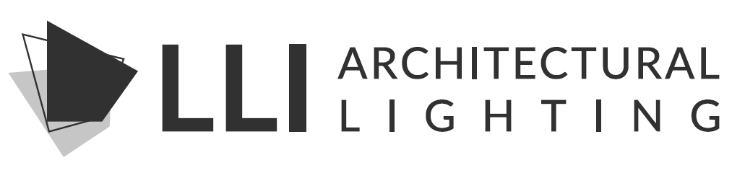
DECLARE
GOAL OF 100% MATERIAL TRANSPARANCY
EXTRUSIONS AND TAPELIGHT
NEON IN LATE 2024
NEXT STEPS IN OUR SUSTAINABILITY JOURNEY
www.llialighting.com

