Slide 1
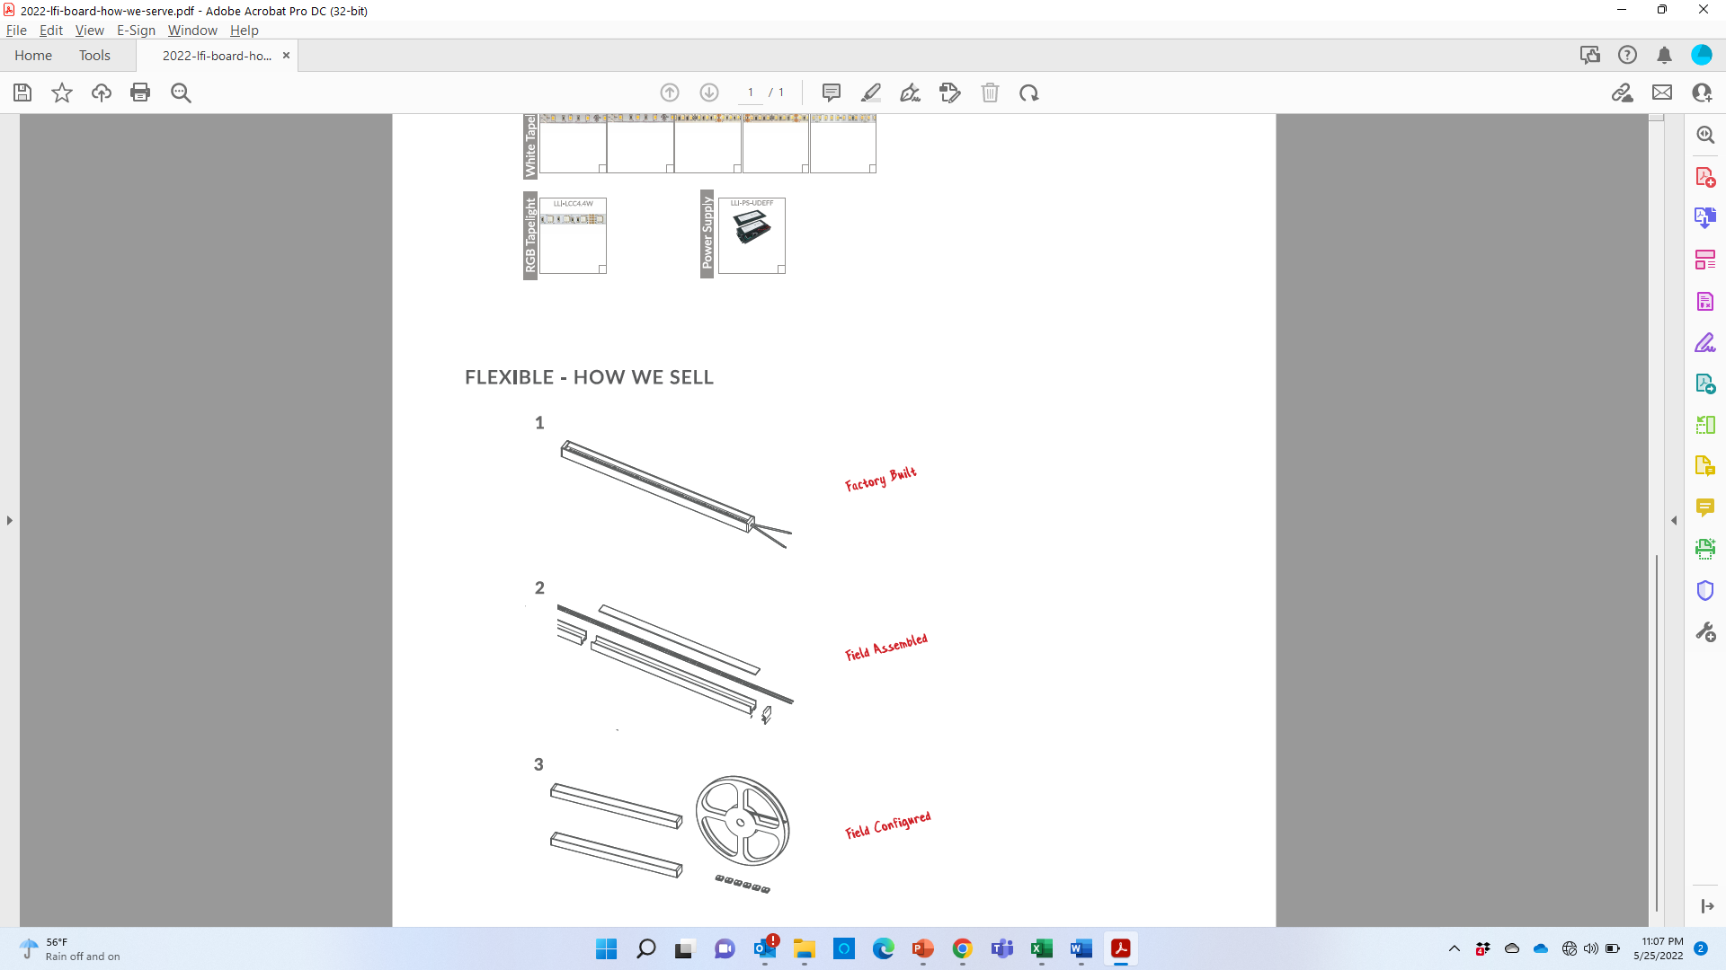

HOW WE SELL
FACTORY
BUILT
FIELD
ASSEMBLED
FIELD
CONFIGURED
Uncut Reels
Pre-cut w/ soldered lead
How it ships
Built to spec and pre-assembled (if <94”)
Uncut (48” or 94”)
Uncut (48” or 94”)
Connectors & jumpers
Price
$DN PF
-15%
-35%

