Slide 1
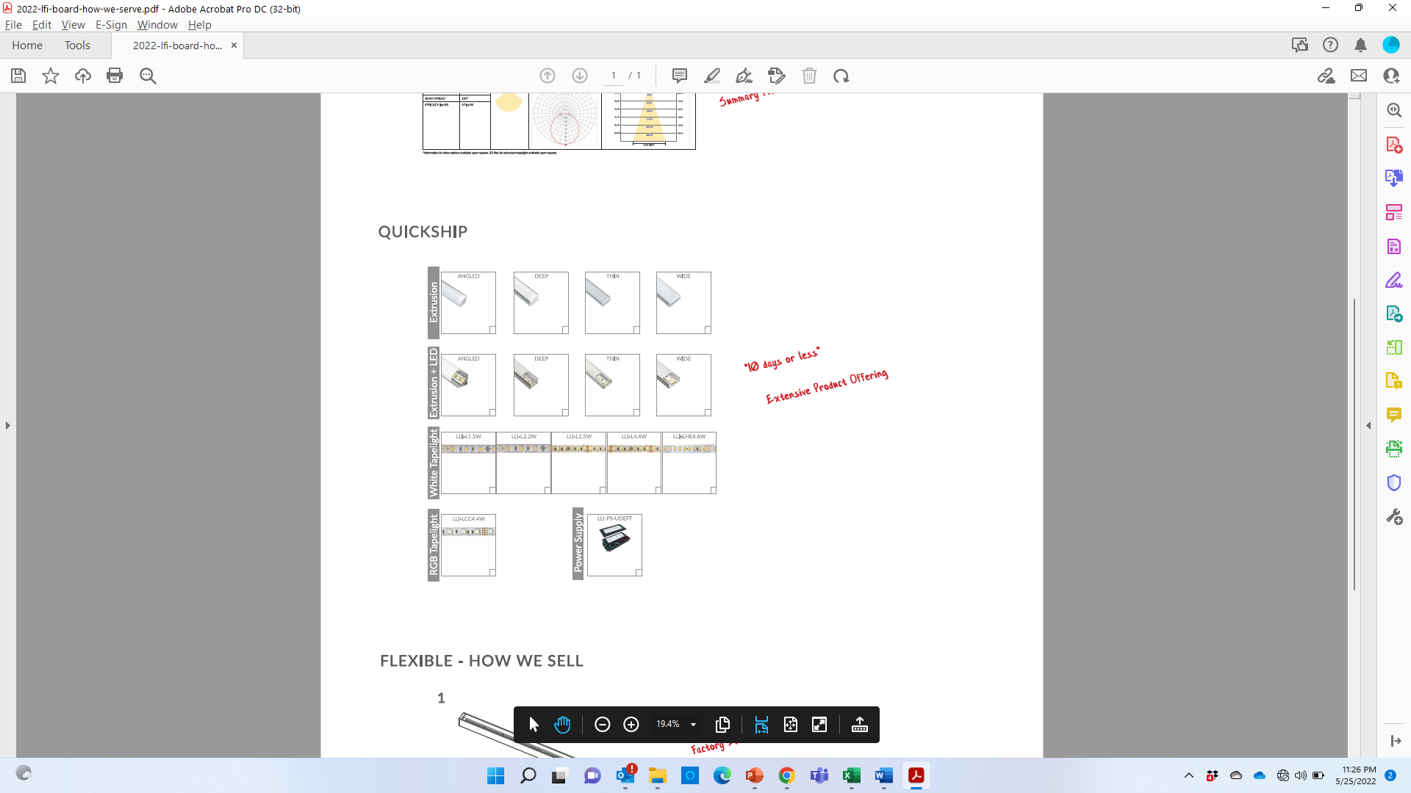

OUR QUICKSHIP PROGRAM
“2 WEEKS OR LESS”
Notes:
Take a foto of this slide

