Slide 1
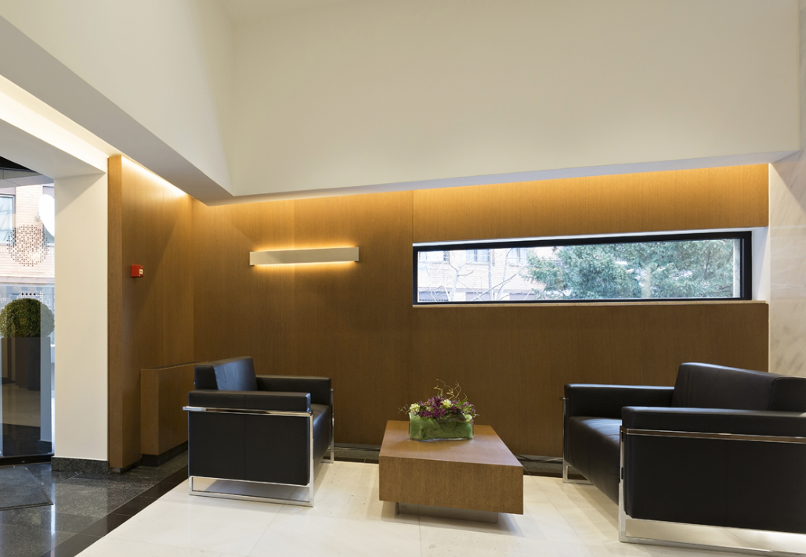
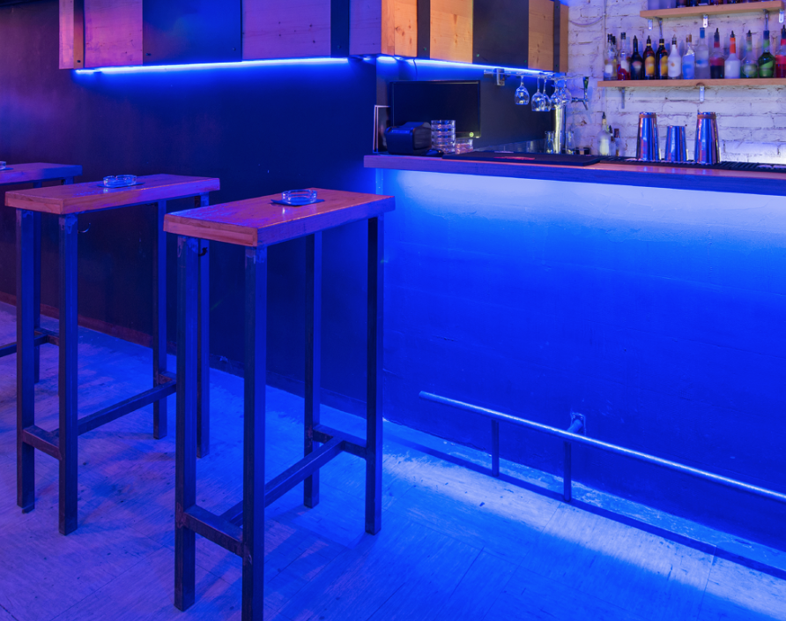
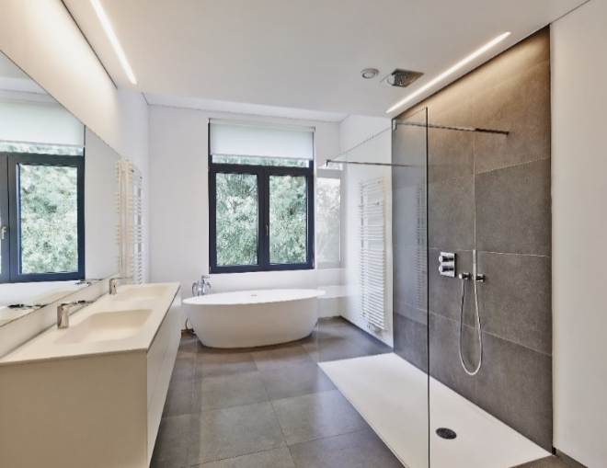
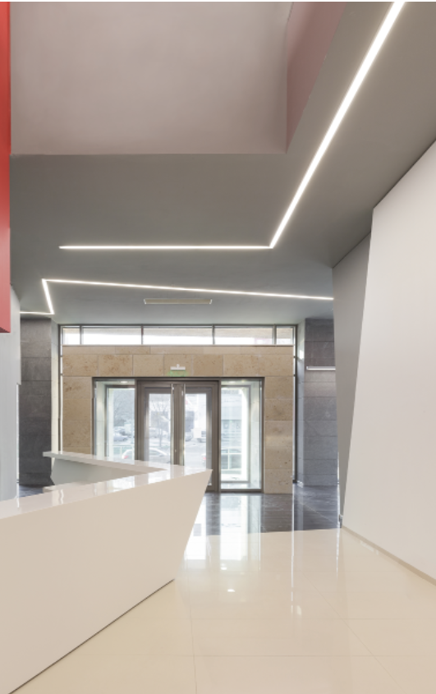
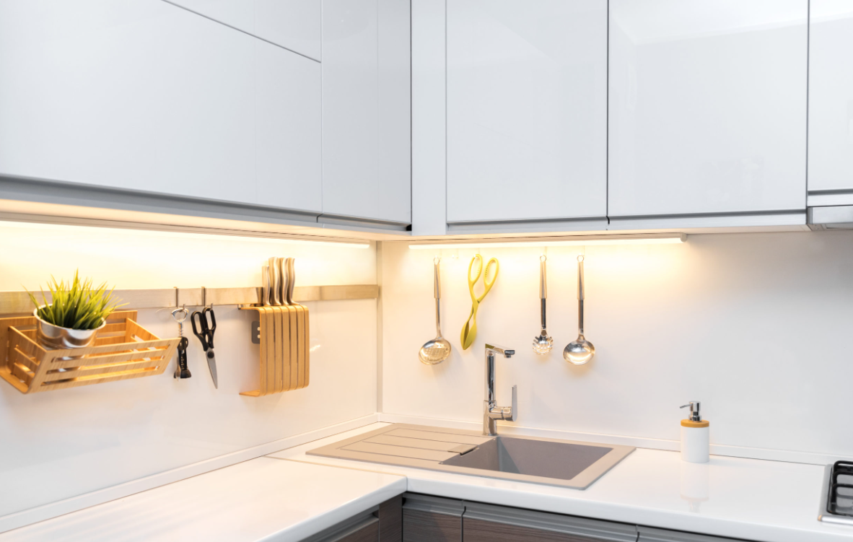
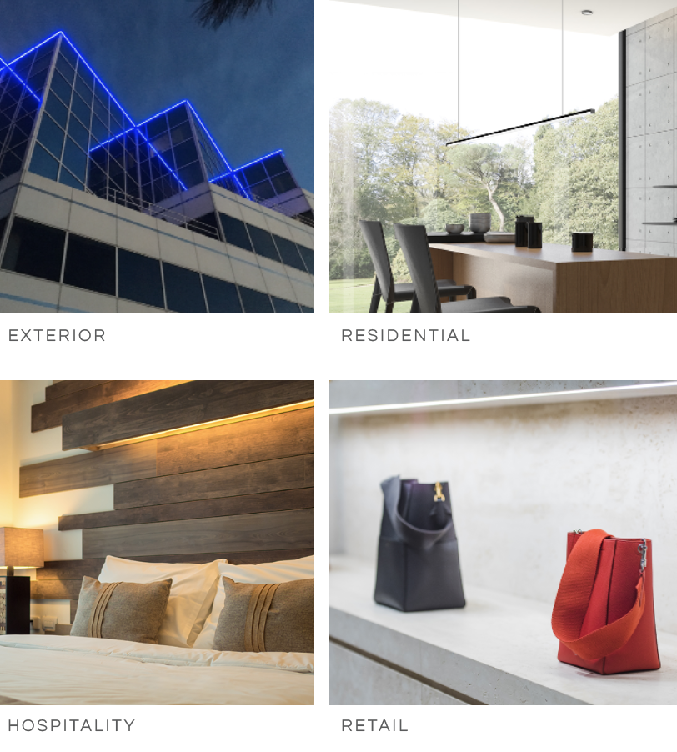
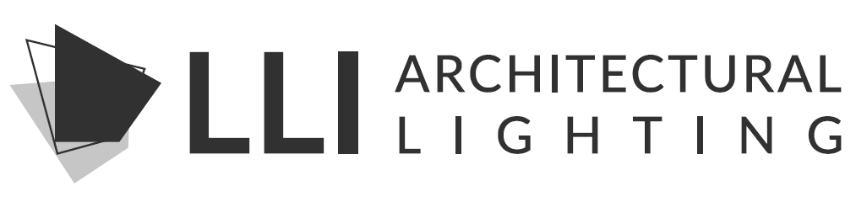
WHAT WE DO
STATIC WHITE / WARM FADE
COLOR CHANGING / FIXED COLOR
WET/DAMP LOCATION
RESIDENTIAL
HOSPITALITY
RETAIL
EXTERIOR
“Connecting Light and Architecture”
COMMERCIAL

