Slide 1
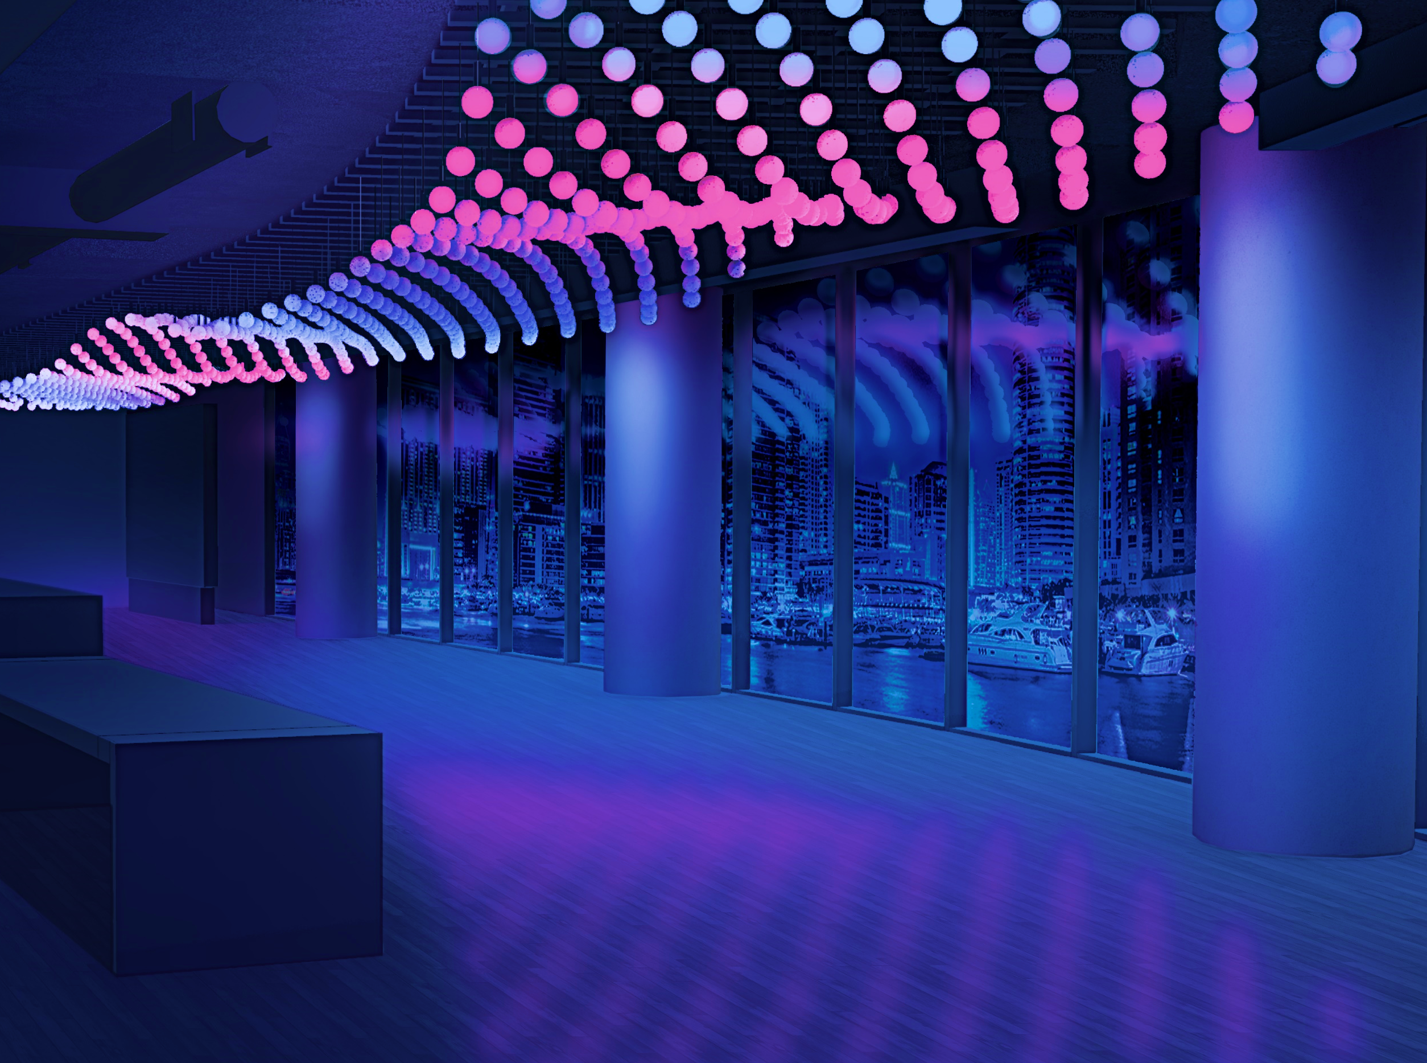


Lighting Architecture Entertainment
Hyatt Tap
Hugh Lighting Design / Gensler
Hyatt Regency in Chicago, IL
www.RGBLights.com

