Slide 1
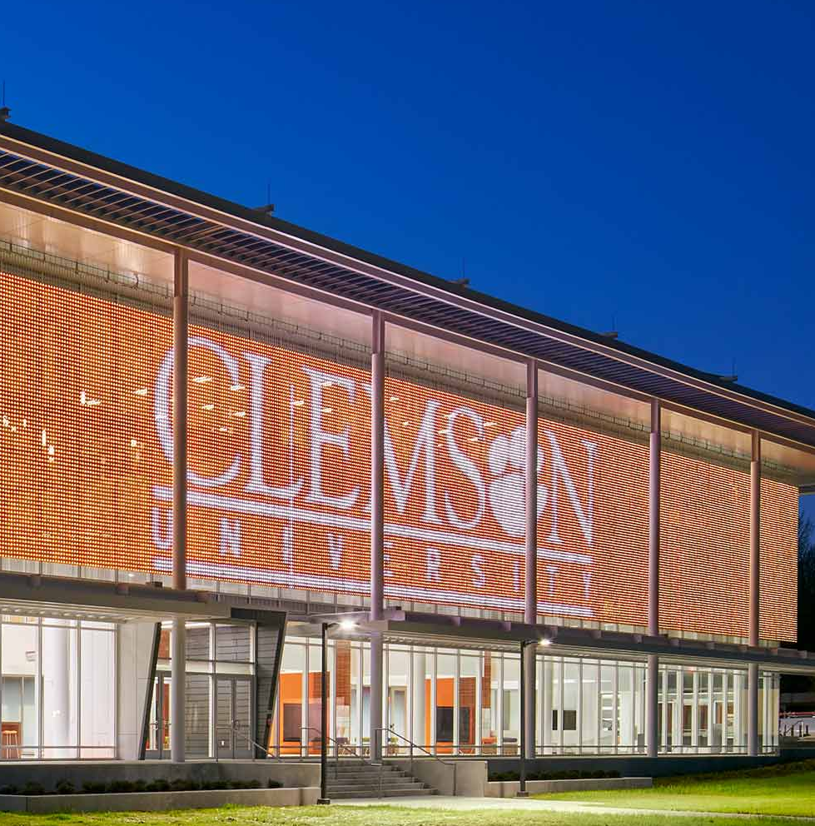

Engage, inform and entertain with programmable lighting solutions.
Engage, inform and entertain with programmable lighting solutions.
Clemson Innovation Center
Specifer: Perkins + Will
Location: Clemson, Alabama

