Slide 1
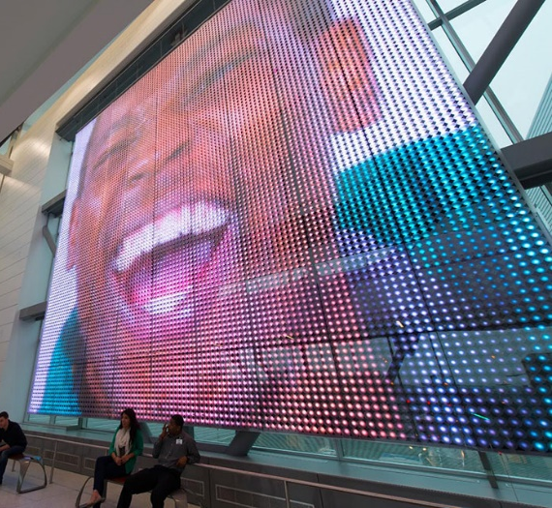




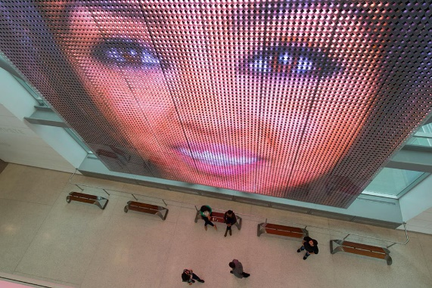

HAVE LAPTOP.
WILL TRAVEL .
Consult
(Remote availability)
Program
Connect
Deploy
“College Faces”
Artist: Cameron McNall, Electroland
Location: Gateway Community College in New Haven Connecticut

