Slide 1
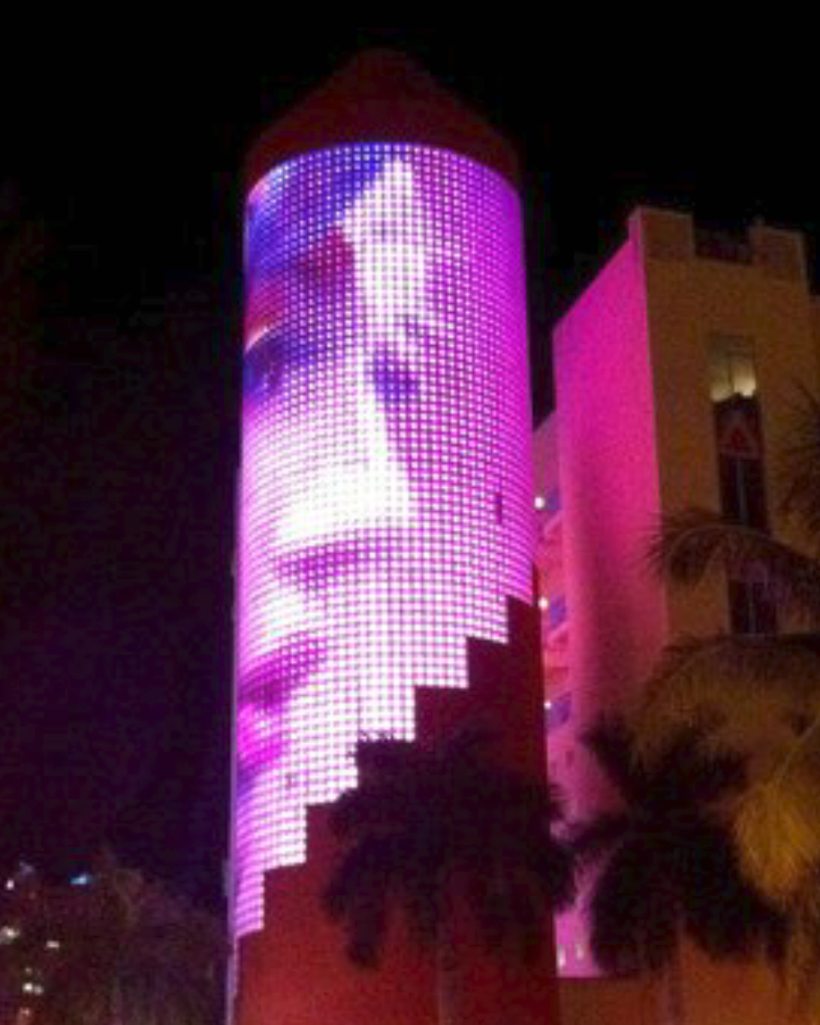







WE ARE ABOUT
DYNAMIC LIGHTING
Irvine Spectrum Wheel
Artists: Forman & Associates, ShowPro, First Circle
Location: Irvine, California
IKON Restaurant
Location: South Beach, Miami

