Slide 1



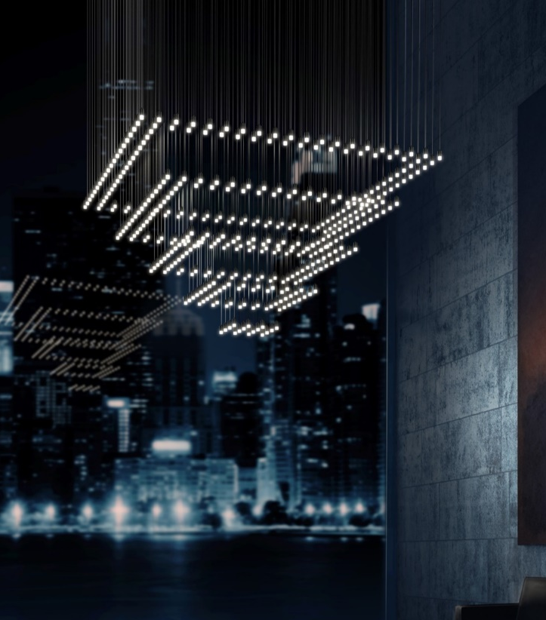
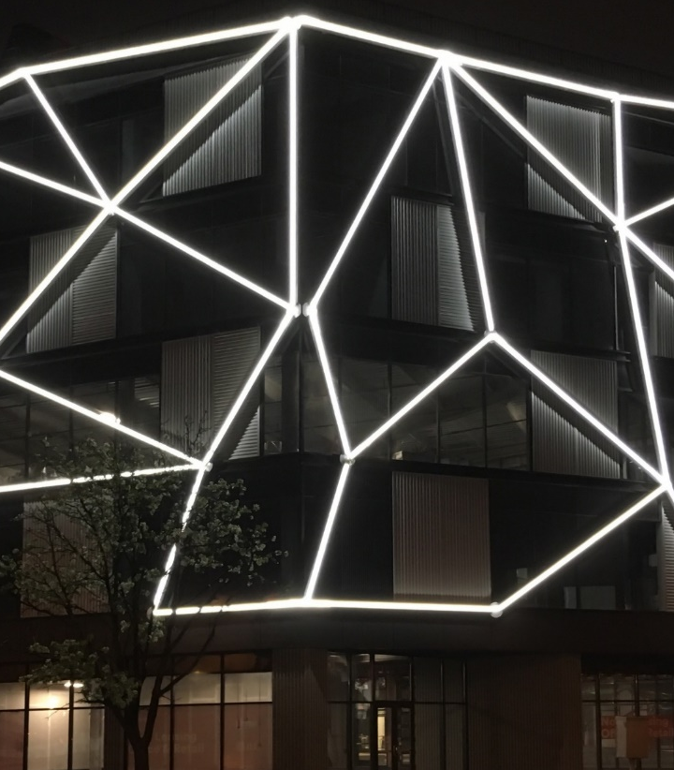
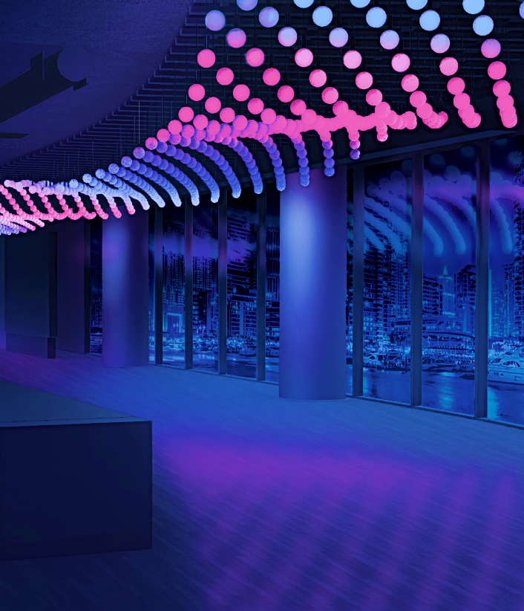
ARCHITECTURAL LUMINAIRES
MICRO LINEAR
DYNAMIC LIGHTING
Notes:
THREE UNIQUE LIGHTING BRANDS UNDER ONE UMBRELLA …B/L/R
PROBLEM IN THE MARKET WE Identified and SEEK TO ADDRESS IS how we “SAVE YOU TIME” by You, I mean the whole value chain.
SO WE ARE ON A MISSION TO DELIVER THE BEST QUOTE TO FULFILLMENT EXPERIENCE

